Slide 1

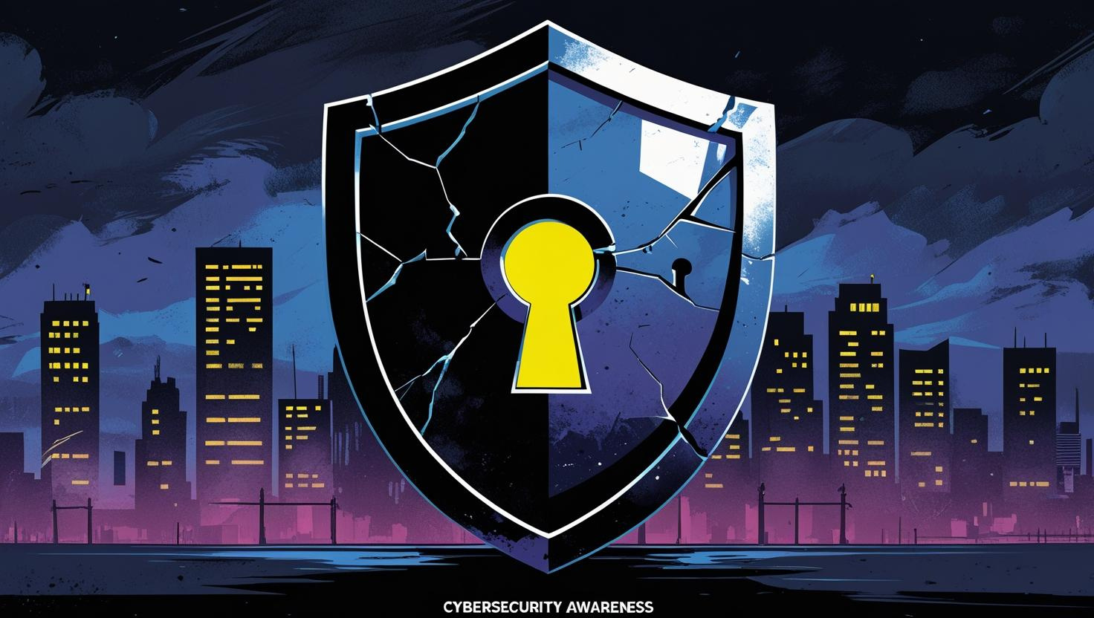
Phishing Awareness Training – CodeAlpha Internship
UNDERSTANDING PHISHING AND STAYING SAFE ONLINE
BY BIGMAN KUMBUYRING ISAAC

Slide 2

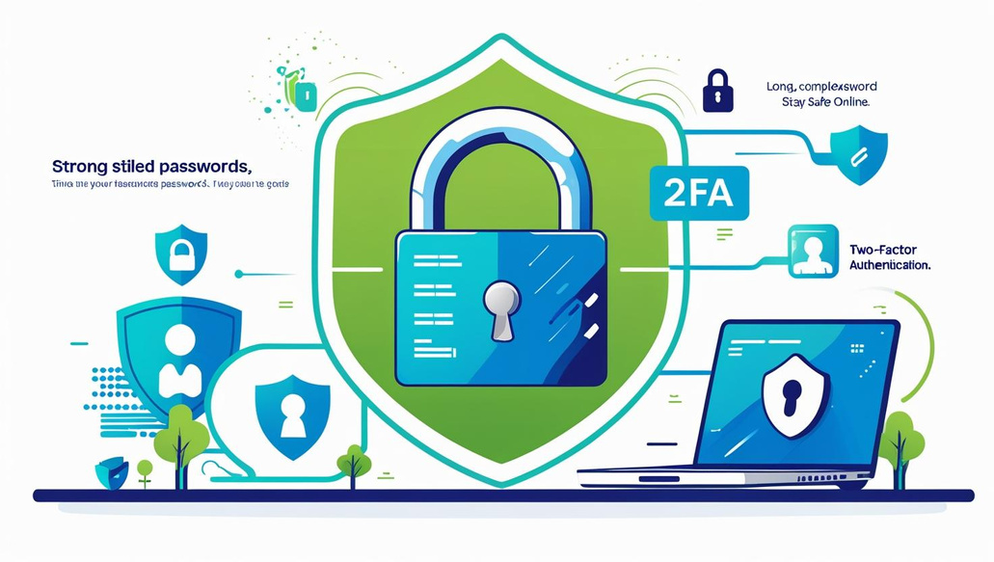
Welcome to Phishing Awareness Training!

Slide 3

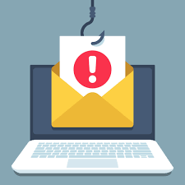
What is Phishing?
Phishing is a cybercrime aimed at tricking individuals into revealing sensitive information. Its roots trace back to the mid-1990s, evolving with technology.

Slide 4
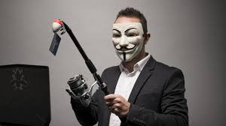


The Dangers of Phishing
Phishing attacks can lead to severe financial losses. They compromise sensitive information, disrupting businesses and causing significant reputational damage to victims.
In 2022 alone, phishing attacks caused billions in losses, highlighting the urgent need for awareness and proactive measures against these threats.

Slide 5


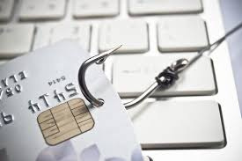
Understanding Common Types of Phishing
01
Email phishing targets large groups of users.
02
Spear phishing focuses on specific individuals.
03
Vishing uses voice calls to deceive victims.

Slide 6
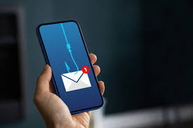
Anatomy of Phishing Email
A phishing email often contains multiple red flags such as suspicious sender addresses, urgent language, and poor grammar. Always verify before clicking links.

Slide 7
Real-World Phishing Examples to Recognize
01
Phishing emails often mimic legitimate sources.
02
Fake login pages can steal your credentials.
03
Screenshots highlight common phishing tactics.

Slide 8
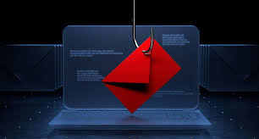
Spotting Phishing Attempts
To avoid phishing, always check the sender's email address carefully, hover over links before clicking, and watch for urgent language or spelling errors.

Slide 9

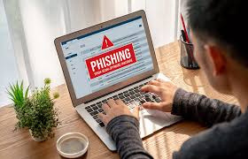
Stay vigilant! Recognize phishing red flags to protect yourself and your organization from potential scams.

Slide 10
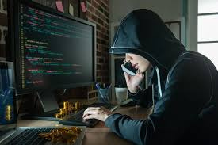
Social Engineering Tactics
Understanding these tactics is crucial; awareness is key to protecting yourself and your organization from phishing attacks. Stay informed and vigilant.
Social engineering tactics exploit human psychology to manipulate individuals. They aim to trick users into providing confidential information or performing actions that compromise security.

Slide 11

Phishing on Social Media
Phishing attempts on social media platforms can be deceptive and convincing. Users must remain vigilant to protect their personal information from malicious actors.

Slide 12
Phishing via SMS and Calls
Phishing attacks are not limited to emails; smishing (SMS phishing) and vishing (voice phishing) are also common tactics used by attackers.

Slide 13

Phishing in the Workplace
Phishing attacks can lead to significant losses for businesses, compromising sensitive data and undermining trust in corporate communications. Awareness is crucial to mitigate these risks.

Slide 14
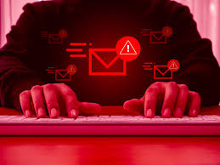
Major Phishing Attack
In 2020, a significant phishing attack targeted a well-known financial institution, leading to the compromise of thousands of customer accounts and sensitive data.
This incident underscores the importance of vigilance in recognizing and reporting phishing attempts to protect personal and organizational information.

Slide 15

Lessons Learned
Incorporating lessons learned from this case is vital for strengthening defenses against phishing and ensuring a more secure workplace environment.
The recent phishing incident revealed crucial insights into employee awareness. It highlighted the importance of continuous training to combat evolving cyber threats effectively.

Slide 16

Best Practices to Stay Safe from Phishing
01
Enable 2FA for enhanced account protection.
02
Avoid clicking on unknown or suspicious links.
03
Always verify requests for sensitive information.

Slide 17

Steps to Take If You Suspect Phishing
01
Report the suspicious email to IT immediately.
02
Do not click any links in the email.
03
Verify the sender's identity through other means.

Slide 18
Welcome to Phishing Awareness Training!

Slide 19
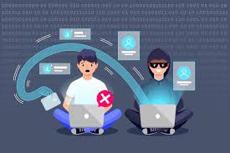
Interactive Quiz: Test Your Phishing Knowledge
01
Identify phishing attempts with confidence.
02
Learn effective strategies to stay safe.
03
Challenge yourself and improve your skills.

Slide 20
Essential Resources for Phishing Awareness
01
Visit Cybersecurity & Infrastructure Security Agency.
02
Read the Anti-Phishing Working Group guidelines.
03
Explore the latest phishing trends on Google.

Slide 21
Stay Aware, Stay Safe
Awareness is critical in combating phishing. Share resources with colleagues and encourage them to remain vigilant against potential threats. Visit our GitHub repo for more information: [GitHub link here].

Slide 22
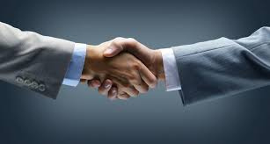

Thank You
PRESENTED BY
BIGMAN KUMBUYRING ISAAC

